Slide 1


Welcome, Player
Ludwik Bacmaga, Arnold Bukachi, Chun lee

Slide 2

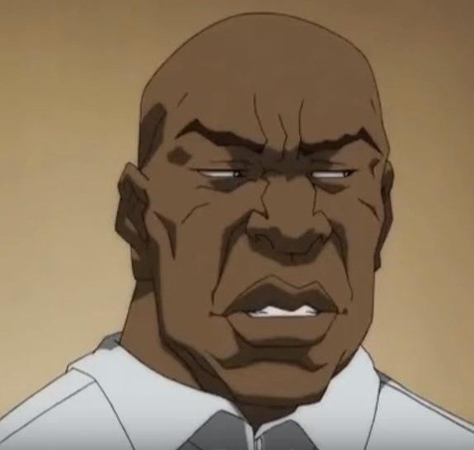

The Team
Ludwik Bacmaga, Modelling + Programming
Arnold Bukachi, Game Design + Management
Chun Lee, Programming

Slide 3
The Project
NINJA! Shine
Augmented Reality Stealth Puzzler
Logo design subject to change. All rights reserved.

Slide 4
The Research
INSERT 1st point
INSERT 2nd point
INSERT 3rd point

Slide 5
The Research
INSERT 1st point
INSERT 2nd point
INSERT 3rd point

Slide 6
The Research
Gold mine waiting to be dug
MekaMon
Future add-on to product

Slide 7
Tech Demo
INSERT/EMBED VIDEO OF TECH DEMO

Slide 8
Thanks!
Dzięki!
Asante!
谢谢!

Slide 9
Shout Outs
https://twitter.com/crowbargordon (Gordon Freeman)
https://youtu.be/srcVg142yCQ (Philbert Stowlove)
http://street-fighter-sprites.wikia.com/wiki/Category:Street_Fighter_II_series_Icons (Chun Li)

